Slide 1
Trial to Paid Conversion Prediction

Slide 2
Background
Client company is in the media streaming business. Users have the option of starting a free trial subscription and % of those users become paid subscribers.
Problem:
To find a model to predict whether a user will convert or not.

Slide 3
Approach
Feature Hypothesis Generation and Data Exploration:
Identification of variables that can impact conversion
Analysis based on the scoping in previous step to identify final data set
Data Preparation & Data Cleansing
Processing of features for model intake
ML feature selection for feature set validation and discovery
Outlier treatment
Modeling
Testing of different ML models (XGBoost and RandomForest)
Fit best model

Slide 4
Feature Hypothesis and Data Exploration:
During feature hypothesis generation, identified 40 possible features that showed strong relationships to conversions.
SQL and Tableau were were the primary tools used.
Through EDA and data exploration, looking at user activity/traits during each day of the trial period, ended up with 18 viable features for the model.
Used pandas-profiling to identify which features needed to be transformed, which needed imputation of values, and which needed outlier treatment.
Removed features that didn’t have enough sample, features with strong relationships with other features, and features that only applied to a subset of the users.

Slide 5
Data Preparation & Data Cleansing
Used count and sum of null functions to identify gaps in my data.
Converted nontype objects into either float or strings so that I could use simple imputer for where there were null values.
Applied either mean or most common value as applicable.
Used get dummies function in order to run my categorical through the model.
Checked the distribution once more using pandas profiling.
Applied power transform on several features in order get the right distributions and to remove outliers.

Slide 6
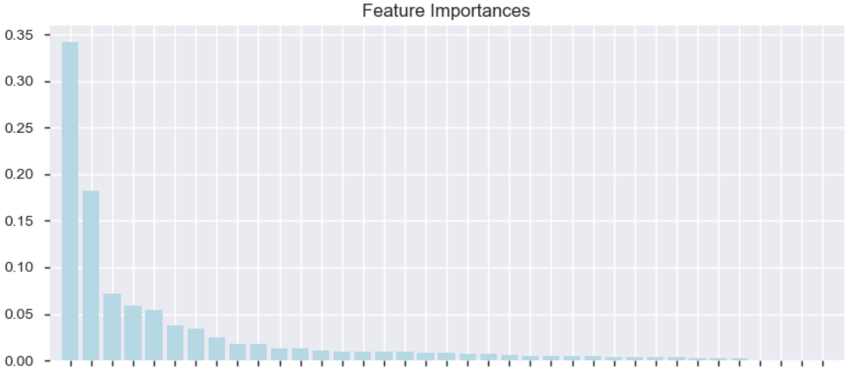
Modeling
Used RandomForest to identify the relative importance of each feature.
Used RandomForest, XGBoost, and DecisionTree classifiers to find the best fit.
XGBoost was the winner with a fit of 63.4%
Testing an array of values it seemed to be able to predict correctly.

